Slide 1
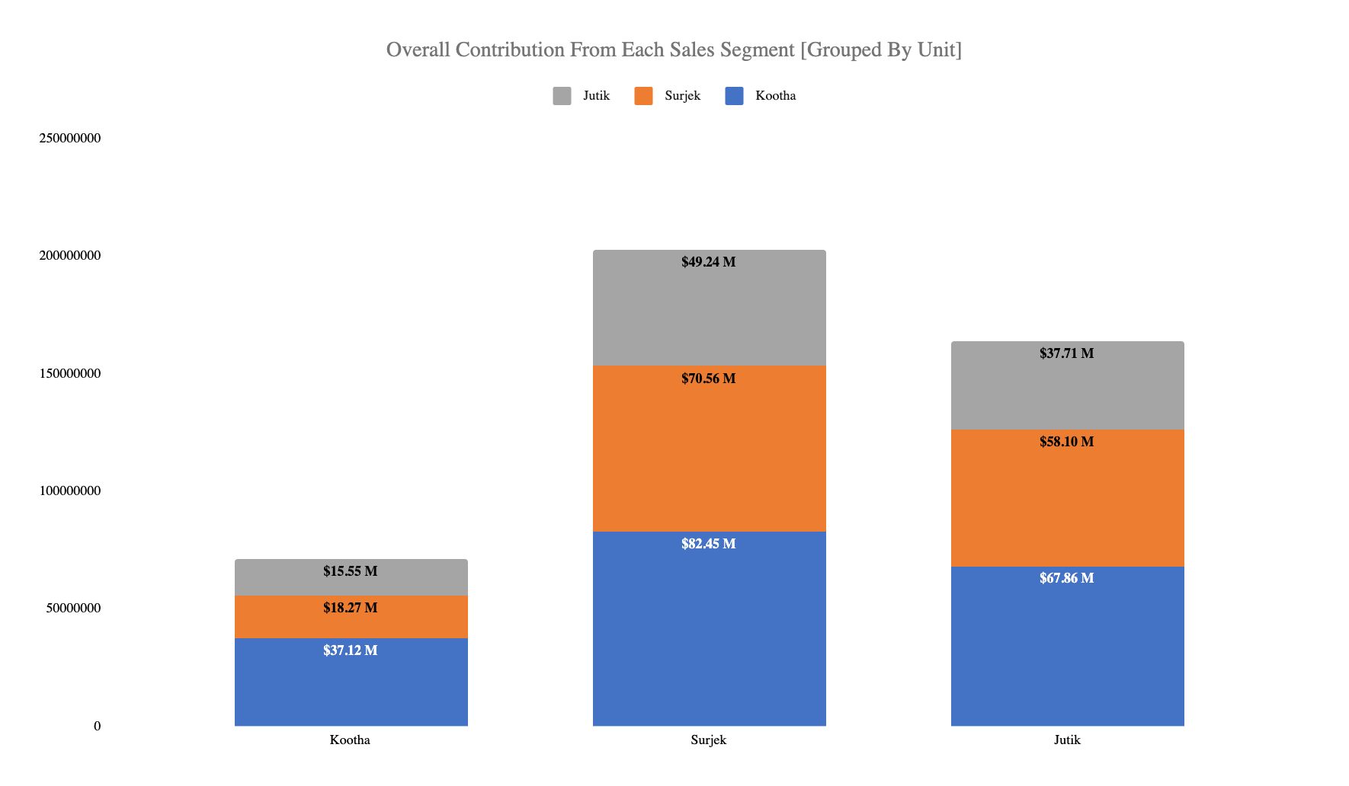
Segmentation of the revenues by unit, reveals that of the three (3) customer segments, Surjek are the most popular, followed by Jutik ($37.71M) and lastly Kootha Sales ($37.12M).

Slide 2
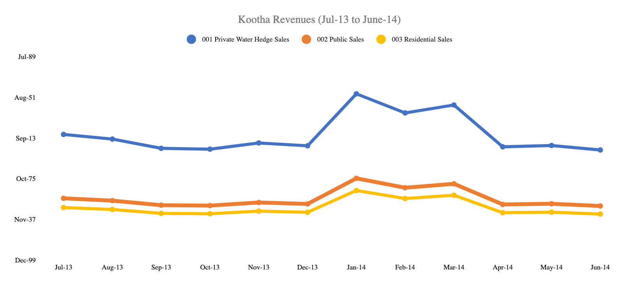
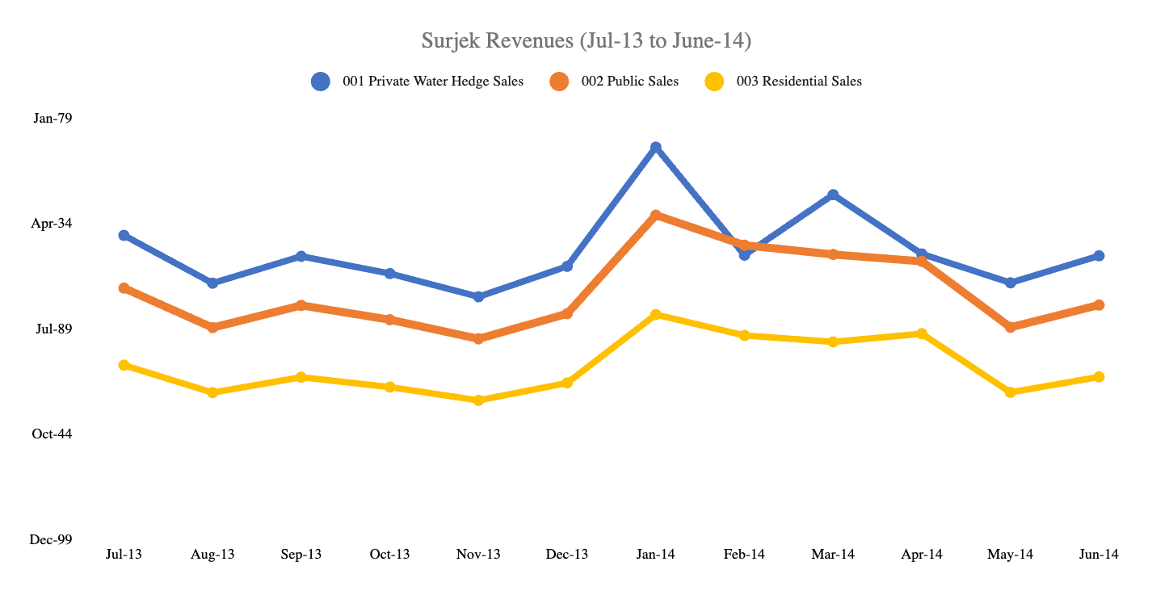
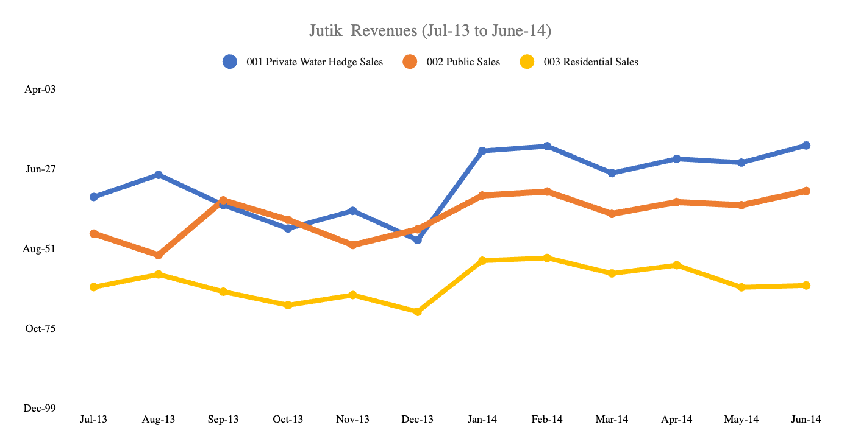
Of the ($37M)¹ in Revenue Sales over the July-2013 to June-2014 Period, Surjek provides close to 50% of Sales Volumes ($202M), with Jutik ($ 163 M) and Kootha ($70M) providing the remaining.
Note: This refers to the Total Sales for all 3 Units (Kootha, Surjek and Jutik)

Slide 3
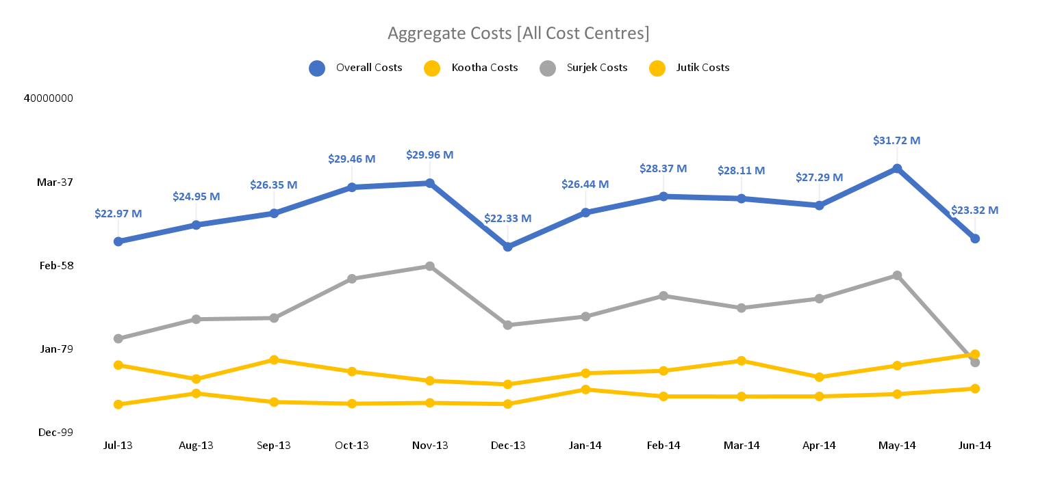
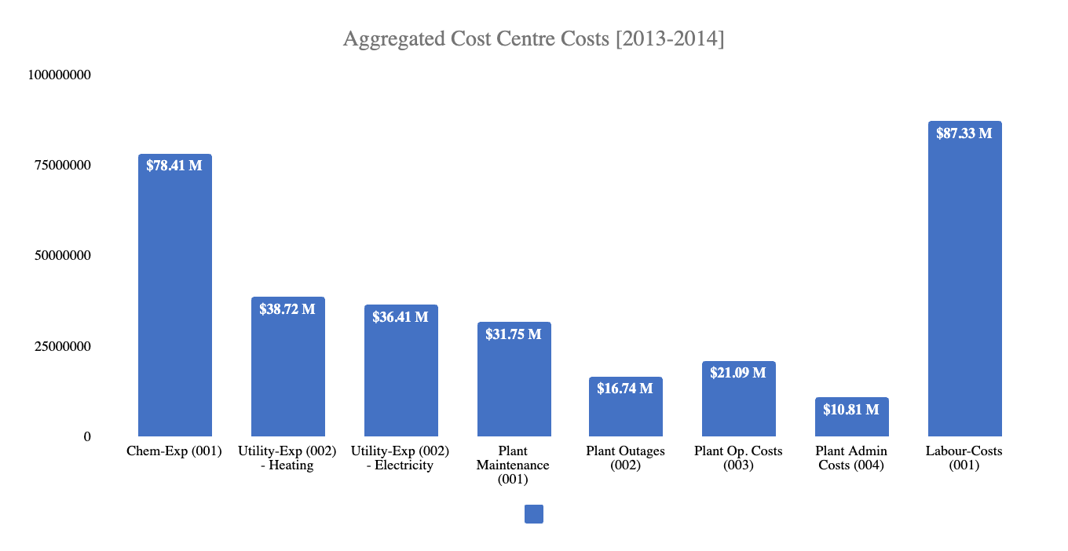
Targeted Expense Analysis reveals an interesting trend; Overall Costs sharply increase from December, with $22.3M, contributing $23.32M towards the overall cost-base.

Slide 4
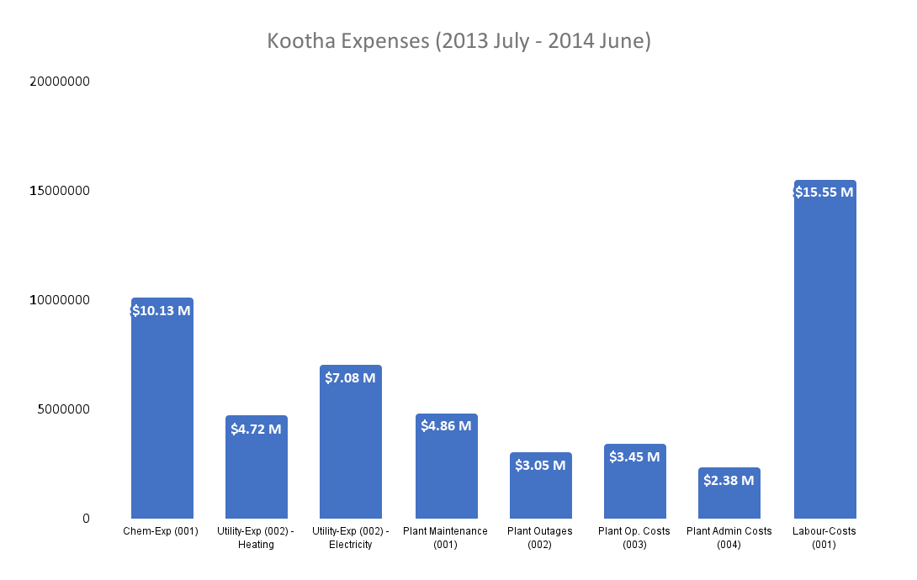
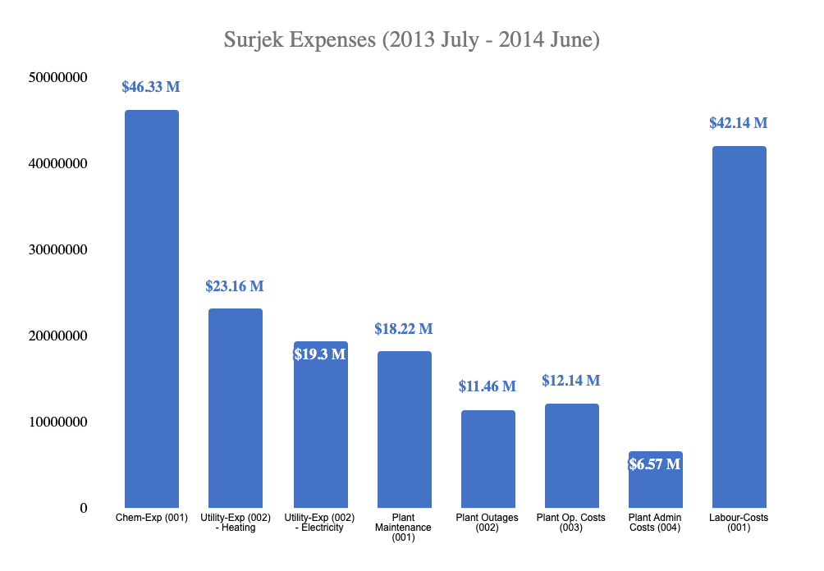
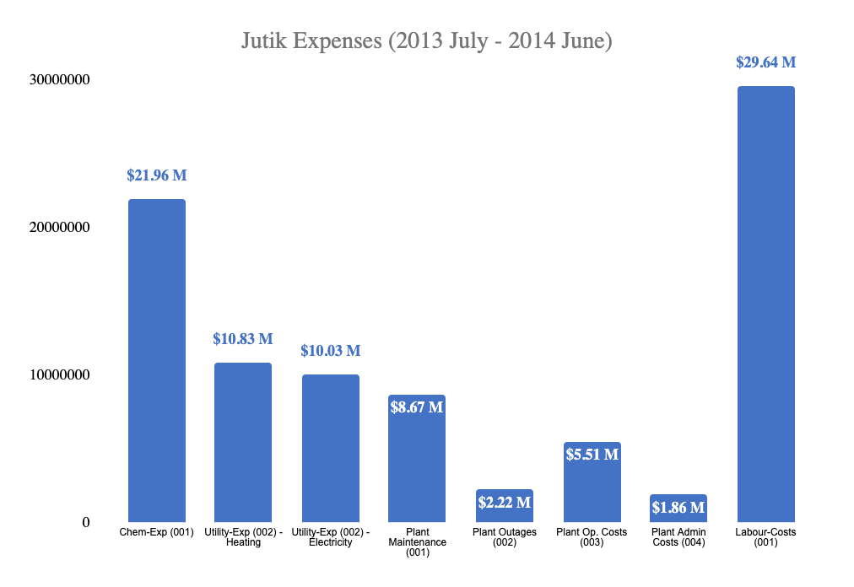
Further analysis singles-out with Surjek ($46.33M) worth of expenses, contrasted to a much lower spend from Jutik ($21.96 M) and Kootha ($10.13M), largely due to lower Chemical and Labour Expenditure.

Slide 5
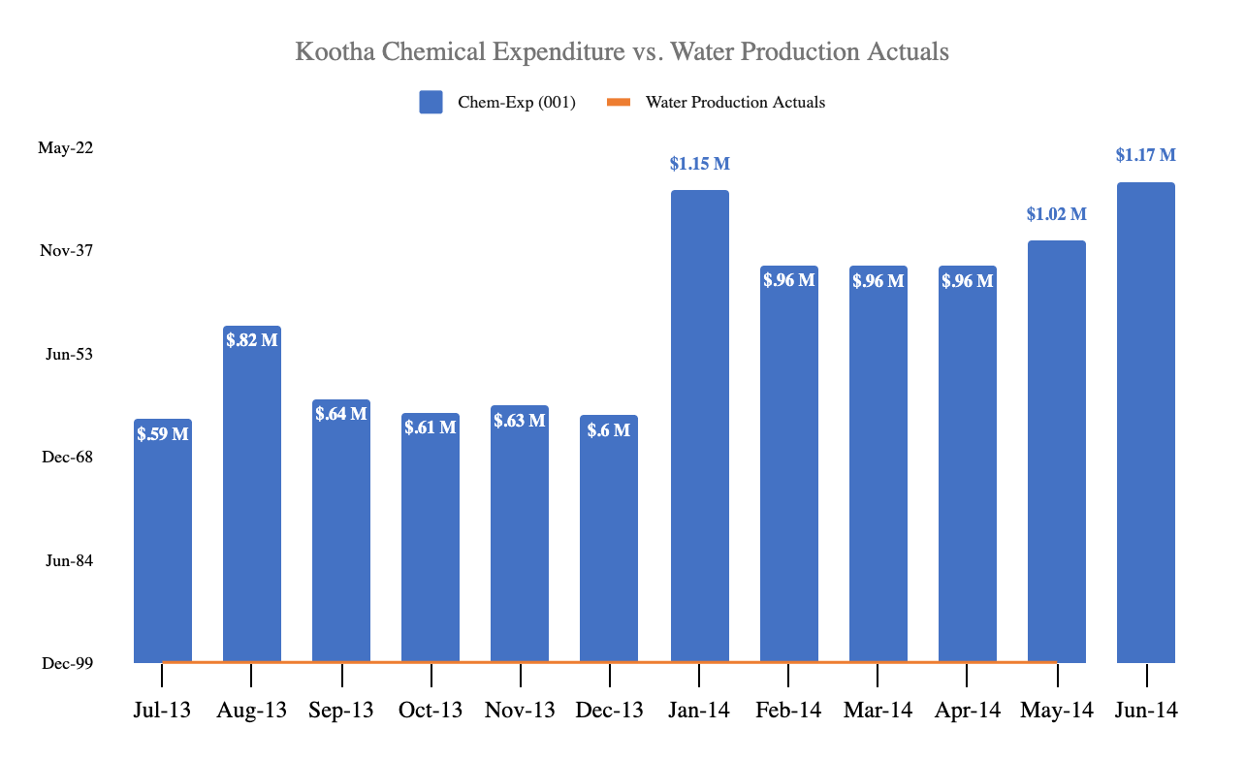
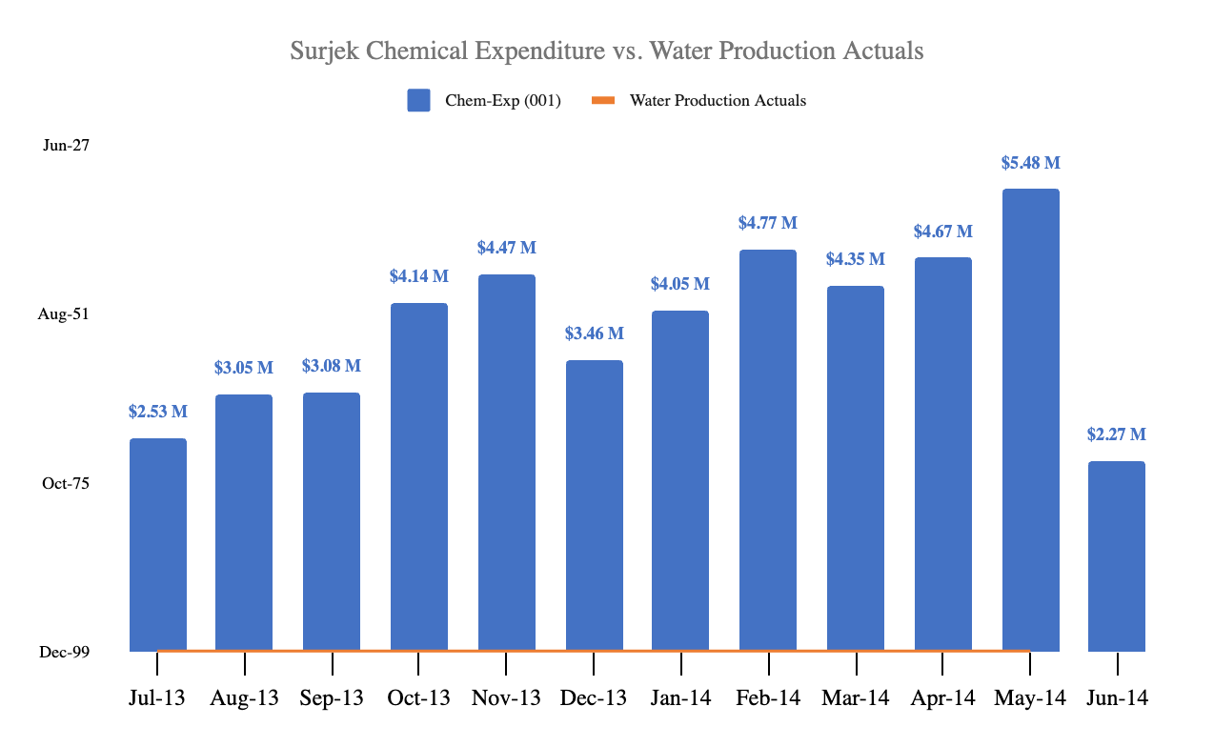
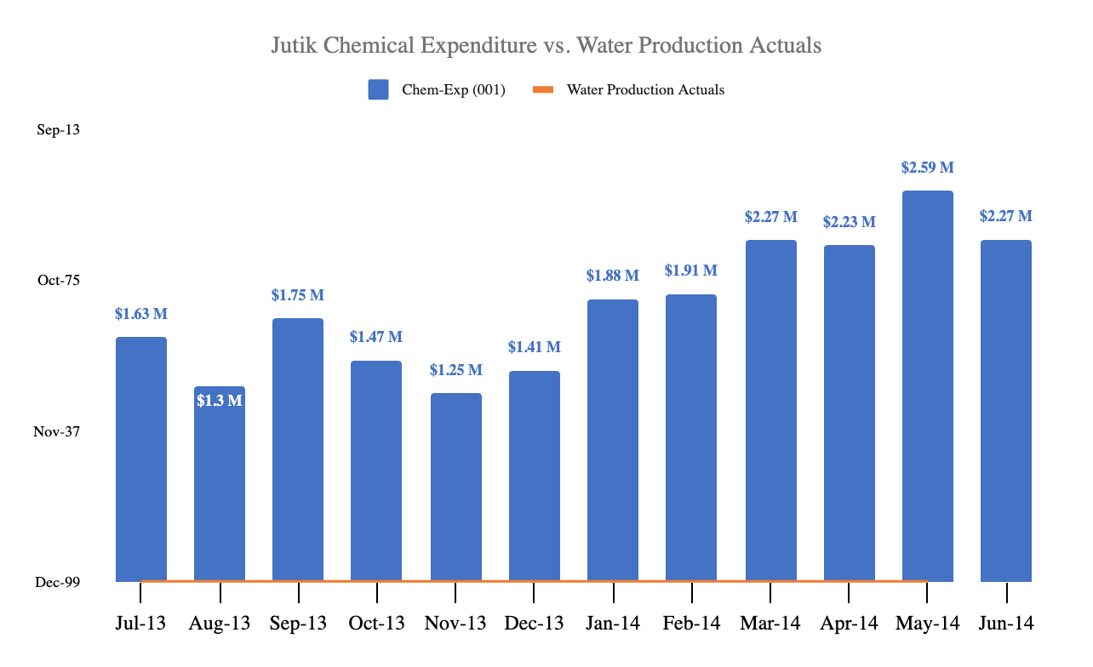
Drilling-down to the cost-element level, reveals an indicative relationship between water production and chemical expenditure with this being particularly pronounced for the Surjek ($5.48M) Unit which coincidentally has the highest rate of water production.

Slide 6
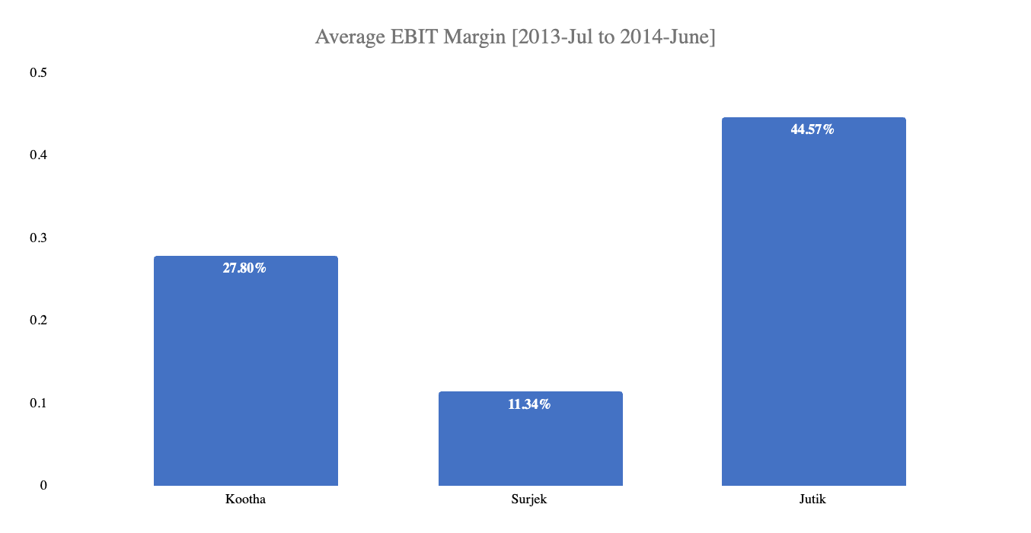
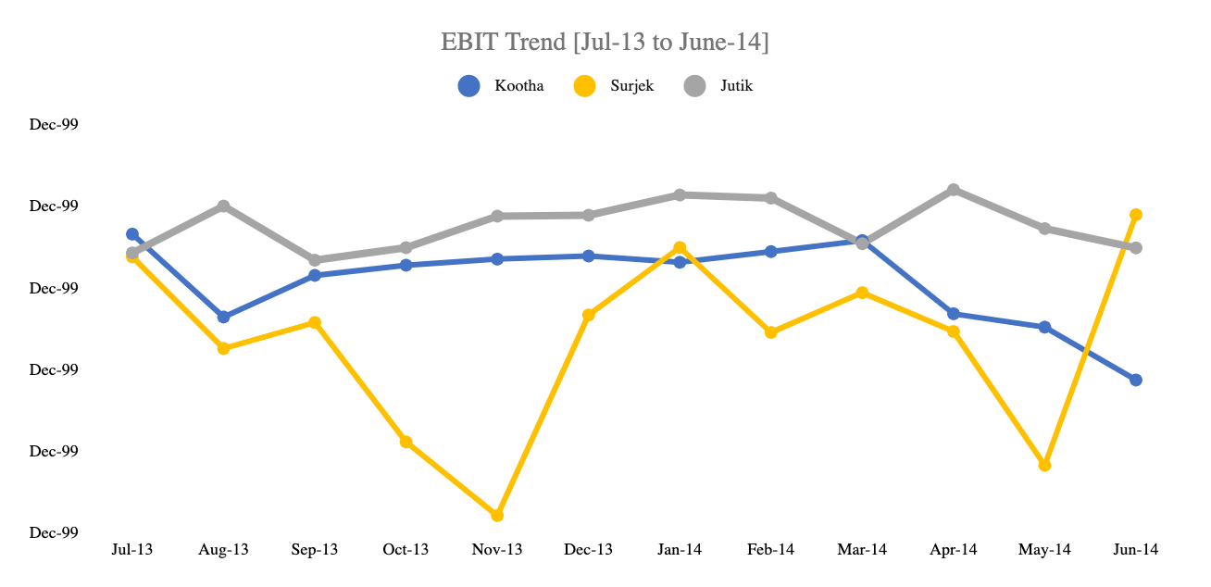
Concluding our analysis, Jutik has the highest overall EBIT contributions ($72.94M), followed by Surjek($22.94M) , and lastly Kootha ($19.72M). However, from an EBIT Margin (%) perspective, Kootha has a higher margin than that of Surjek, indicative of a lower revenue-to-expense ratio.¹
Note:¹ We can clearly see for Surjek over the October, November and May Periods – expenses were far higher than revenues which contributed to this lower revenue-to-expense ratio.

